Slide 1
Brushless DC (BLDC) Motor

Slide 2
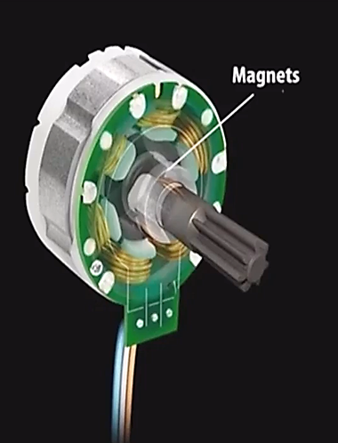
Content:
Principle of BLDC motor
Types of BLDC Motor
Construction of BLDC Motor
Working of BLDC Motors
Advantages, Disadvantages and Applications of BLDC Motor

Slide 3
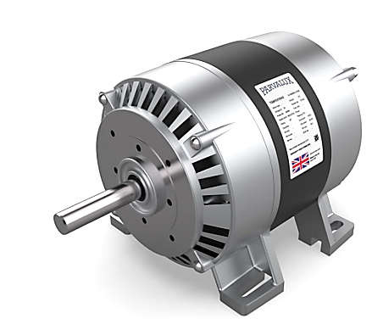
What is BLDC Motor?
A brushless DC motor (known as BLDC) is a permanent magnet synchronous electric
motor which is driven by direct current (DC) electricity and it accomplishes electronically controlled commutation system.
Commutation is the process of producing rotational torque in the motor by changing phase currents through it at appropriate times.

Slide 4
Principle of BLDC Motor
BLDC motor works on the principle similar to that of a conventional DC motor, i.e., the Lorentz force law which states that "whenever a current carrying conductor placed in a magnetic field it experiences a force".
As a consequence of reaction force, the magnet will experience an equal and opposite force.
In case BLDC motor, the current carrying conductor is stationary while the permanent magnet moves.

Slide 5
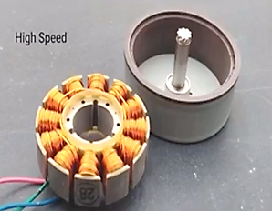
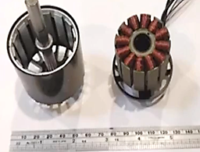
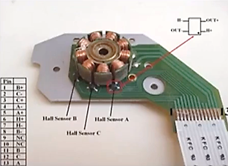
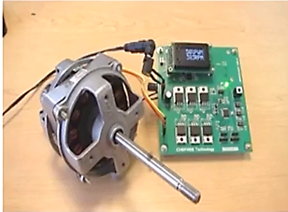
Types of BLDC Motor
Based on Design
In-runner brushless DC motor (also called inner rotor)
Out-runner brushless DC motor (also called outer rotor)
Based on Use of Sensor
Sensored brushless DC motor
Sensorless brushless DC motor
Based on Number of Poles
Single Pole brushless DC motor
Multi pole brushless DC motor
Based on Type of Power Signal
Sinusoidal brushless DC motor
Trapezoidal brushless DC motor

Slide 6
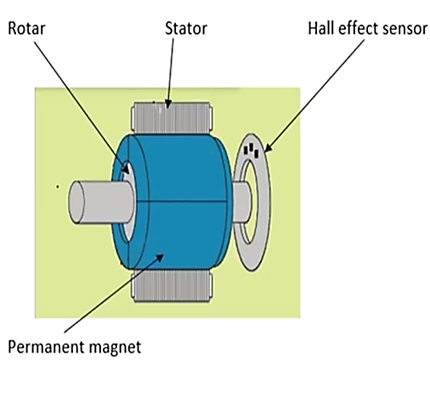
Construction of BLDC Motor
The permanent magnets is attached to the rotor.
The current-carrying conductors or armature windings are located on the stator.
They use electrical commutation to convert electrical energy into mechanical energy.
The main design difference between a brushed and brushless motors is the replacement of mechanical commutator with an electric switch circuit.
A BLDC Motor is a type of synchronous motor in the sense that the magnetic field generated by the stator and the rotor revolve at the same frequency.

Slide 7
Construction of BLDC Motor
Brushless motor does not have any current carrying commutators.
The field inside a brushless motor is switched through an amplifier which is triggered by the commutating device like an optical encoder.
Out runner - The field magnet is a drum rotor which rotates around the stator. This style is preferred for applications that require high torque and where high rpm isn't a requirement.
In runner -The stator is a fixed drum in which the field magnet rotates. This motor is known for producing less torque than the out runner style, but is capable of spinning at very high rpm.

